Slide 1
SURVEY REPORT ON ANGANWADI CENTRES
Key findings, problems and Suggested Solutions

Slide 2
Six Services Under ICDS
Supplementary Nutrition
Pre School Education
Immunisation
Nutrition and Health Services
Health Check-up
Referral Services

Slide 3
The Survey
Carried out in 20 AWCs in the Ranchi District –
                16 in the Urban Areas of Ranchi
                14 in the Rural Areas of Nagri Block
Anganwadi Workers and Anganwadi Helpers interviewed
3 Local Representatives from the Nagri Block (Mukhiya) and 1 Block Member from the Ranchi District

Slide 4
Key Findings
1) Infrastructure

Slide 5
Shared and Usable
Not Present at all
Present and Usable

Slide 6
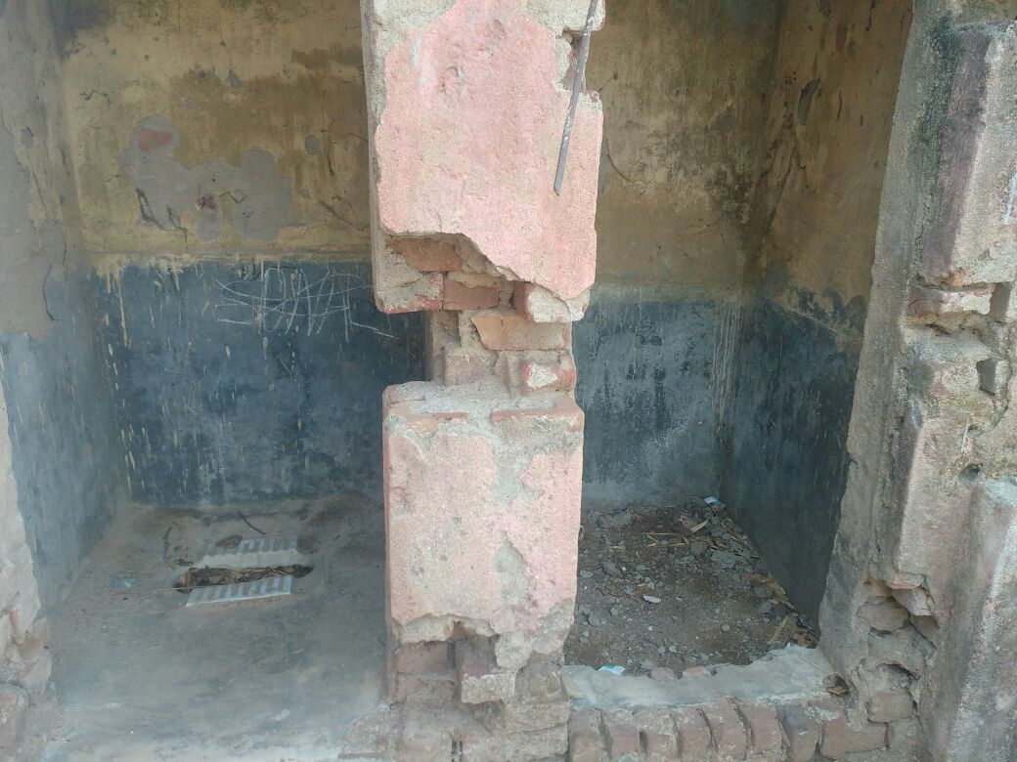
This is what there is in the name of a toilet in the rural centre of
Pundag Bagicha Toli

Slide 7
Irregular Funds
Irregular Honorarium
Less attendance ratio because of play schools
Lack of infrastructure
Too much work load

Slide 8
Clean Drinking Water

Slide 9
Kitchen

Slide 10
2) Irregular Payment
Of funds for food and honorarium

Slide 11
As many as 10 out of the 20 AWWs surveyed complained of irregular payment of funds and honorarium
The honorarium for an AWW is Rs.4,400 and that of an AWH is Rs.2,200
This payment is also irregular – is done once in months, and is often skipped for a few months
It creates a two fold problem
Many centres genuinely face a problem of shortage of funds and hence, of a supply of food grains.
If AWWs are not paid regularly, they can not be held completely accountable for the proper functioning of the AWCs

Slide 12
3) Take Home Ration
Micronutrient Fortified Food Package

Slide 13
Take Home Ration
Exceptionally successful in distribution and procurement.
Not popular among the beneficiaries because of taste preferences.
They demand the distribution of rice and grains again.

Slide 14
Suggested Solutions
Regularised Payments
VHSND Funds for infrastructural development in AWCs
Extensive and regular advertisements and awareness programs for the promotion of Micronutrient Fortified Food Packages
Regular training of members of Local Elected Bodies and decentralisation of power to them.

